Slide 1
New FCC Rules on
RF Safety in Amateur Radio
Chuck Till, K4RGN
August 10, 2021

Slide 2
Questions up front
Is RF dangerous?
  Remember, we’re taking about radiated RF, not conducted RF
  Sometimes
Is this something new at the FCC?
  No, this has been in progress for years
  1998, 2013, 2020, …
Is the FCC over-reacting to crazies?
  FCC did not change any of the exposure limits
Is the FCC picking on hams?
  No, the FCC also changed the rules for ISM, Public Mobile, Satellite, AM/FM/TV Broadcast, FRS/GMRS/MURS/CB,
  and Private Mobile
  FCC provides new “exceptions” to simplify lives of many hams

Slide 3
More questions up front
Why aren’t all the details in Part 97?
  Hams must obey all the FCC Rules, not merely Part 97
  Part 97 does refer to the other relevant Parts
Is the ARRL involved with the FCC on this?
  N9GL (PhD in EE, also PE) is Chair of the ARRL Safety Committee and on the FCC Technological Advisory Council
Isn’t this as simple as running an online RF calculator?
  Not in all cases
  On the other hand, an online calculator might not even be necessary
Can’t I just ignore this?
  Not if you value the safety of your family, neighbors, and yourself
  Not if you want to operate legally

Slide 4
Pay close attention if…
You have an antenna that is
  Inside or close to your home
  Close to a neighbor’s yard or house, a sidewalk, or a street
You are a QRO operator
You use a high-gain antenna
You operate on 10m or 6m
You set up temporary stations, such as for Field Day
You own an HT for 2m
Don’t most hams fall into
at least one of these categories?

Slide 5
What has happened?
FCC eliminated the unique and very lenient treatment that hams enjoyed with respect to RF safety
FCC allowed 24 months (May 3, 2023) for ham stations to come into compliance
  Except that new or changed stations must comply immediately

Slide 6
Terminology
Specific Absorption Rate (SAR) is the governing metric between 100 kHz and 6 GHz
  the rate at which energy is absorbed per unit mass by a human body when exposed to RF, measured in W/kg
  depends heavily on the geometry of the part of the body that is exposed to RF and on the exact location and geometry of the RF source
  FCC requires that mobile phones not exceed 1.6 W/kg, measured in the volume of 1 g of tissue that is absorbing the most RF
Distinctions between
  “occupational/controlled” persons (hams and their families)
  “general population/uncontrolled” persons (neighbors and passers-by)
  Higher allowable exposures for controlled

Slide 7
More terminology
ERP
  Effective Radiated Power (or Equivalent Radiated Power)
  In short, how to measure the combination of a transmitter and the ability of an antenna to direct power toward a given direction
  Power in watts that would have to be radiated by a half-wave dipole antenna to give the same radiation intensity (power flux density in W/m²) as the actual source antenna at a distant receiver located in the direction of the antenna's strongest beam (main lobe)
  Related to, but not the same as, EIRP (“I” for isotropic)

Slide 8
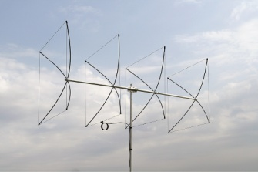
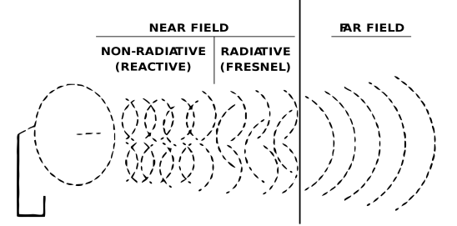
Even more terminology
Near Field
Far Field
∞
Reactive
(λ/6)
Radiating
In the Far Field, we can treat EM radiation like plane waves
But in the Reactive Near Field, things are complex
  hot spots
  effects of nearby objects

Slide 9
Still more terminology
Maximum Permissible Exposure (MPE) calculations can often substitute for SAR
MPE is a far-field calculation, much easier to deal with than SAR
Online calculators for hams are almost always MPE-based
  Usually overstate exposure in the near-field
  Caveat per N9GL: “The only concern of underestimating the exposure with the far-field equation in the near-field occurs with complex antennas, such as small loops and multi element Yagis.”

Slide 10
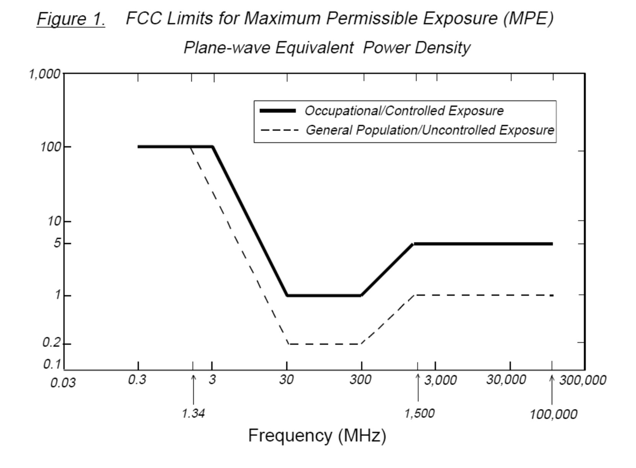
All frequencies are not alike

Slide 11
The way it was, 1998-2021
Categorical exclusions for hams
  No RF evaluation required for mobiles including HTs
  No RF evaluation required for base stations unless power limits were exceeded
    500W on 160-40m, 50W on 10m and VHF, 70W on 440, etc
    Input power to antenna; antenna gain did not matter
  Different rules for repeaters
Otherwise, you had to do an RF evaluation
If evaluation indicated that exposure exceeds limits, the licensee “must take action to prevent human exposure”

Slide 12
But now
Categorical exclusions for hams have been repealed
  Replaced by ham-specific exceptions based on distance, power, and frequency
If you did perform a complete and valid RF evaluation in the past and your station complied, you’re ok
But many hams will not be covered by the exceptions
  Will have to do RF evaluations for the first time
Some hams will have to take measures to come into compliance
  Change their station
  Change their operating procedures

Slide 13
HF (3-30 mHz) exception
RF evaluation may not be needed if ERP is less than
3450 R²/f²
  R is the closest distance in meters, f is frequency in mHz
  With 50 feet of slant distance at 14 mHz, the exception allows as much as 4000 W ERP
  But with 15 feet of slant distance at 30 mHz, the exception allows only as much as 100 W ERP
ERP includes antenna gain (relative to 0 dBd, in this formula) and feed line losses
  It’s easy to exceed 4000 W ERP with a legal-limit amplifier, a directional antenna, and high-quality feedline

Slide 14
… but wait
HF exception does not apply in the reactive near-field
  At 160 meters, the reactive near-field extends 87 feet
  At 10 meters, the reactive near-field extends only 6 feet
You must perform an RF evaluation if the exception does not apply because either
  Anyone (controlled or uncontrolled) is within the reactive near-field, or
  ERP at the distance you’re concerned about is higher than the 3450 R²/ f² formula allows

Slide 15
VHF (30-300 mHz) exception
RF evaluation may not be needed if ERP is less than 3.83 R²
  R is the closest distance in meters (frequency does not matter)
  With 50 feet of slant distance, the exception allows as much as 900 W ERP
  But with 15 feet of slant distance, the exception allows only as much as 80 W ERP
An amplifier or a high-gain antenna is even more likely to put you over the formula’s maximum ERP than at HF
Good news is, reactive near field at VHF is short
  3 feet at 50 mHz, 1 foot at 144 mHz
Bad news is, the FCC’s baseline 20 cm requirement for SAR trumps the ham VHF exception

Slide 16
UHF (>300 mHz) exception
If the antenna is more than 40 cm away, the formula for maximum ERP in watts is 0.0128 R² f
  R is closest distance in meters, f is frequency in mHz
  With 50 feet of slant distance at 440 mHz, the exception allows as much as 1200 W ERP
If the antenna is 20-40 cm away, the formula is 2.04 f
  f is frequency in gHz
  At 440 mHz, the exception allows as much as 0.9 W ERP
If the antenna is less than 20 cm away, there is a specific UHF-only exception from doing SAR

Slide 17
If I can’t claim an exception?
Perform an RF evaluation, as long as you’re in the clear on short-range SAR
  Online calculator
  Modeling with EZNEC (take note, users of unusual antennas)
  Actual measurements (impractical for almost all hams)
There are many online calculators, but last week the ARRL gave us http://arrl.org/rf-exposure-calculator
  Inputs: power at antenna, mode, duty cycle, frequency, antenna gain
  Outputs: minimum safe distance for controlled persons, minimum safe distance for uncontrolled persons
Do this repeatedly to cover all combinations of bands, modes, radios, and antennas that you use

Slide 18
If people are too close?
Increase the height AGL of your antenna
Relocate your antenna
For a steerable antenna, don’t use certain azimuths
Use antenna(s) that null the objectionable azimuths
Decrease transmit power
Decrease antenna gain
Decrease duty cycle
Quit operating on certain bands

Slide 19
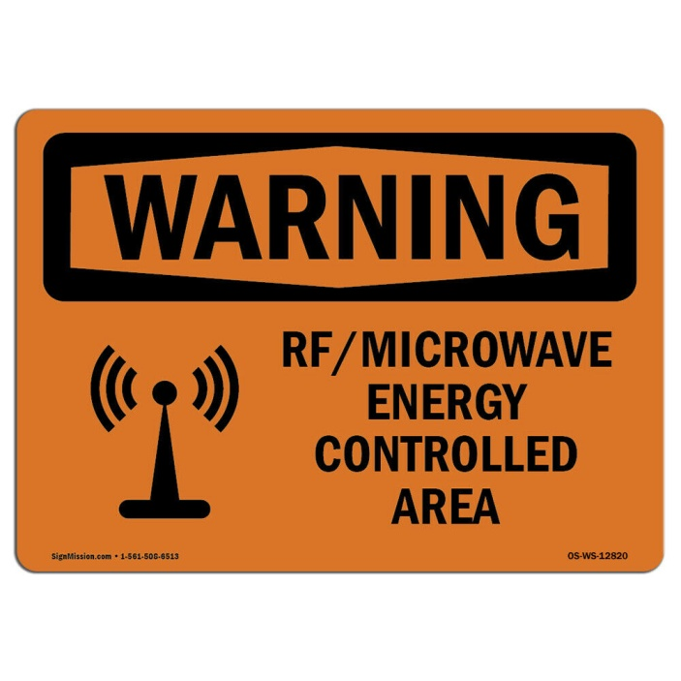
More ideas…
If the problem is only with uncontrolled persons who come and go, don’t operate when they are nearby
Keep people away with fences, ropes, signs

Slide 20
What about 2 meter HTs?
As far as I know, no ham HT has ever been tested for SAR
  However, similar HTs for other services (e.g. private mobile) have been tested for SAR
  Any testing that has been done, or will be done, uses the antenna(s) provided by the manufacturer
  So, beware of after-market antennas
Remains to be seen how the suppliers of ham HTs will respond
HTs manufactured prior to May 3, 2021 are grandfathered-in

Slide 21
Other considerations
New RF rules apply to
  Field Day
  Demonstration and GOTA stations at hamfests
  Temporary foxhunt, contesting, and QSO Party stations (e.g. FM13 at Fort Fisher)
  DX expeditions at sites under U.S. jurisdiction
  QRP
Keep records of the analysis of your station
Do not submit to FCC, but must show the analysis to the FCC upon their request
  Neighbor concerned about RF exposure or simply just irritated by the sight of your antennas

Slide 22
References
Beware of material prior to May 2021
ARRL FAQ
  http://www.arrl.org/files/file/Technology/RFsafetyCommittee/RFXFAQ.pdf
Video by N9GL at https://vimeo.com/540342124
An ARRL book from 1998, http://www.arrl.org/files/file/Technology/RFsafetyCommittee/RF%20Exposure%20and%20You.pdf
FCC OET Bulletin 65, August 1997
  https://transition.fcc.gov/Bureaus/Engineering_Technology/Documents/bulletins/oet65/oet65.pdf and Supplement B for Radio Amateurs
  Fred Maia, W5YI (SK) was a contributor

Slide 23
A learning opportunity
Operate responsibly and legally
73
Chuck Till
k4rgn at arrl.net

